Slide 1
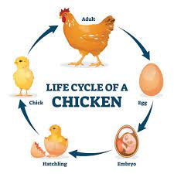
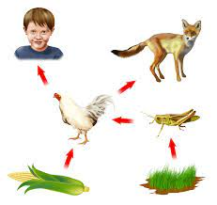
WARM UP
Welcome back. NO INB. Just a pencil today!
Compare and contrast: How is a life cycle and a food web similar?
How is a life cycle and a food web different?
Remember class expectations: Voices off when teacher is talking.
Stay seated unless directed.

Slide 2
Extension Pre Lesson
Salmon Life Cycle and Impacts

Slide 3
In the Lesson you will:
Research and record notes and sketches on each stage of the salmon life cycle.
Read and highlight articles to understand what impacts salmon. Record ideas on your note taking form.
At the end of the lesson you will be able to:
Create a salmon life cycle with details on salmon life stages and impacts they face to their populations.

Slide 4
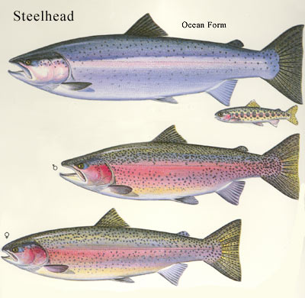
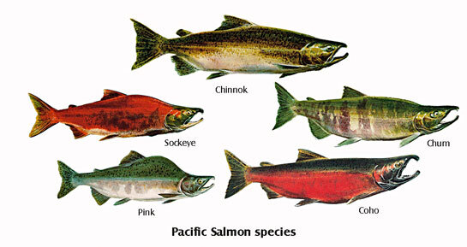
Vocabulary:
Salmonid: The family of species that includes trout like rainbow trout and steelhead trout, as well as salmon species, like Chinook (king) salmon.
Resident species: Species that live in a water body year round. They live in the same territory.
Anadromous species: The term that describes fish born in freshwater who spend most of their lives in saltwater and return to freshwater to spawn, such as salmon

Slide 5
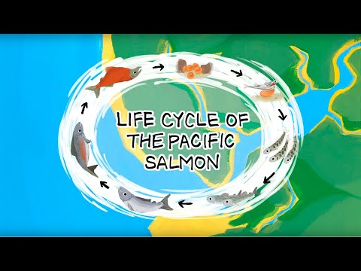
Research
Listen carefully to the stages of the salmon life cycle.
Use the images and text to construct a salmon life cycle with your table partner.

Slide 6
WARM UP
Welcome back. NO INB. Collect a pencil and your Salmon Life Cycle notes.
In your table group think of as many impacts to salmon as possible in one minute.
Share out. Each table group say one impact they can think of. You can’t say the same thing.
Remember class expectations: Voices off when teacher is talking.
Stay seated unless directed.

Slide 7
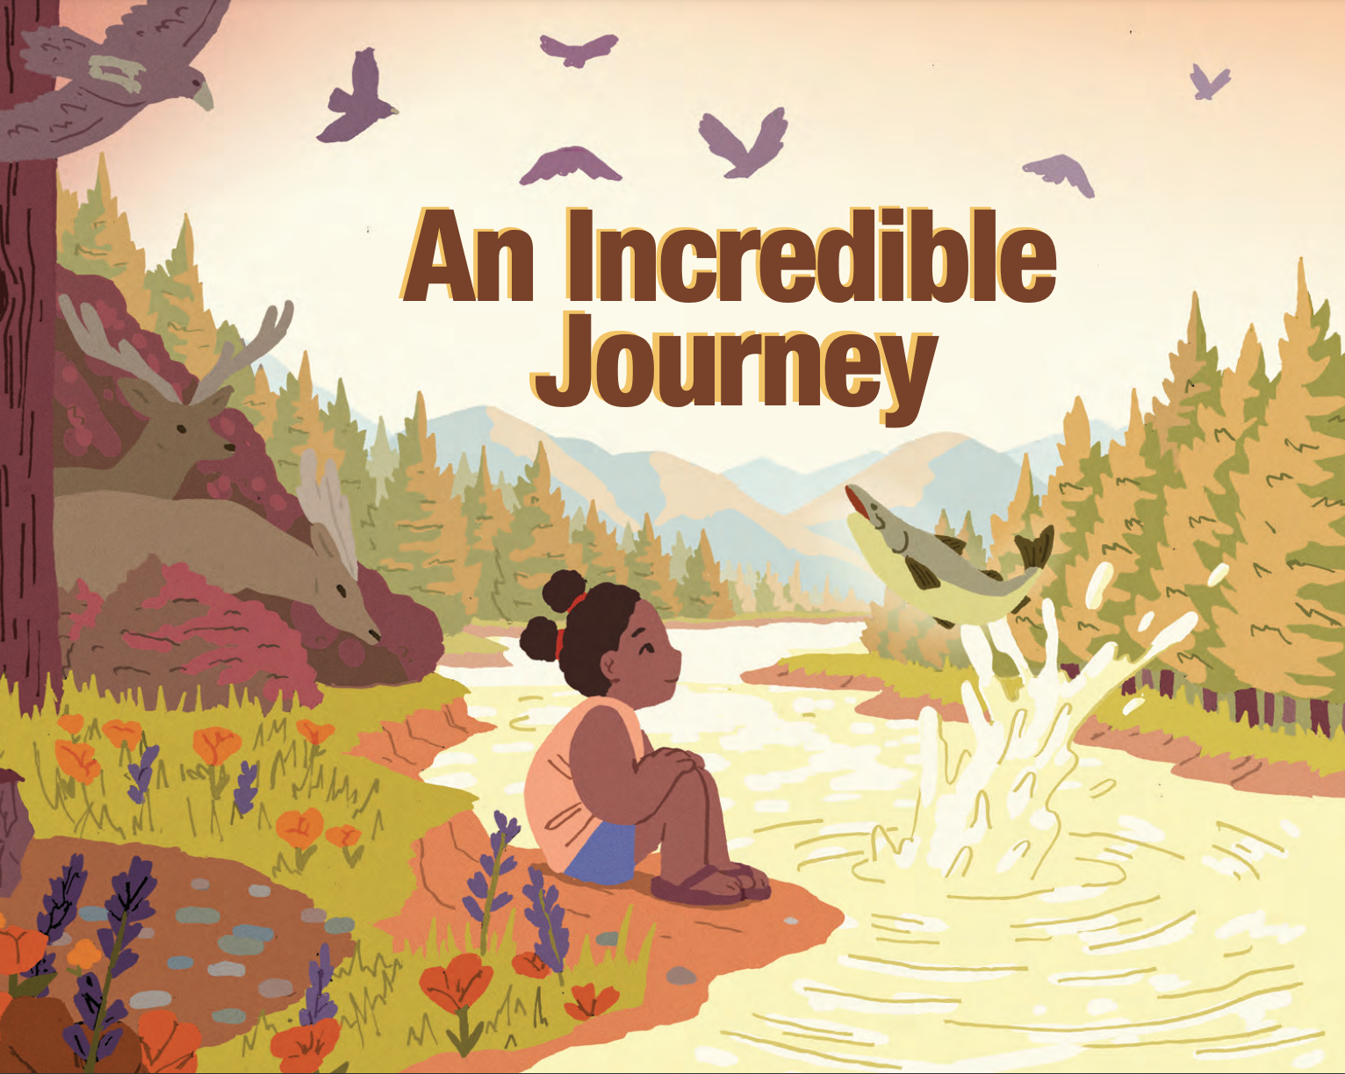
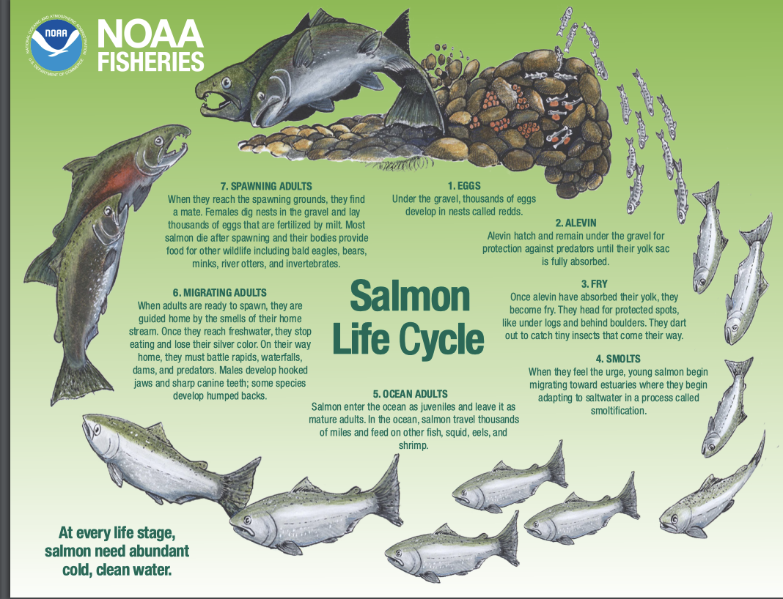
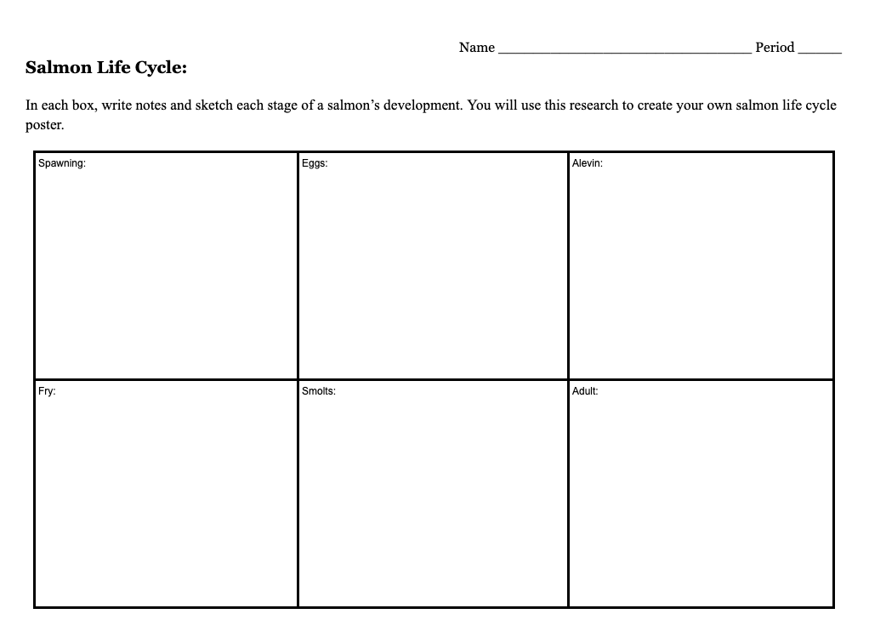
Research: What is the life story of a salmon?
Research:
Use the reading and materials available to complete notes on salmon life cycles for each stage of their lives.
Notes:
https://media.fisheries.noaa.gov/dam-migration/an_incredible_journey_-_2019626_-_508_compliant.pdf Find pages 18-19

Slide 8
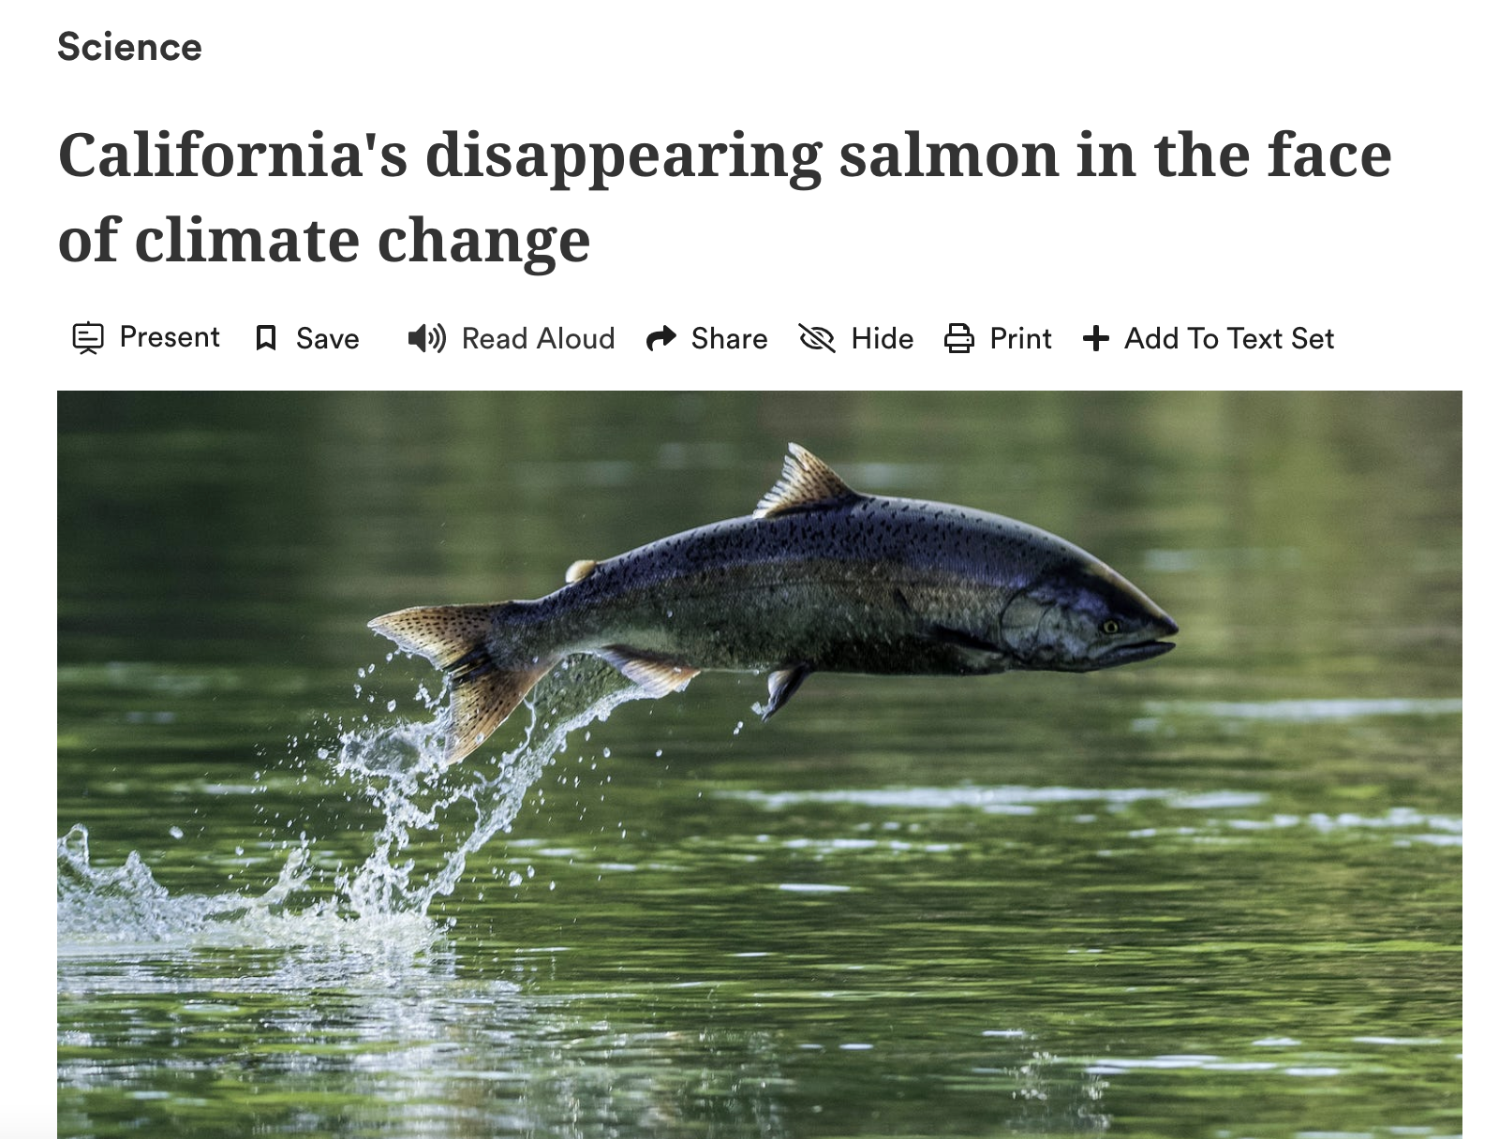
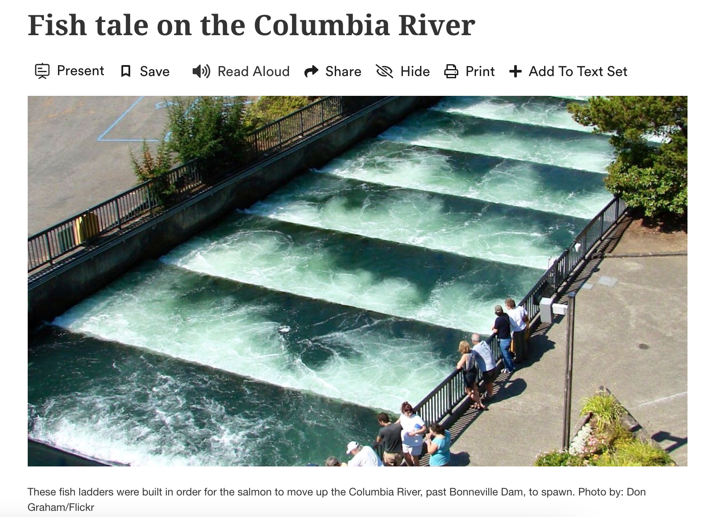
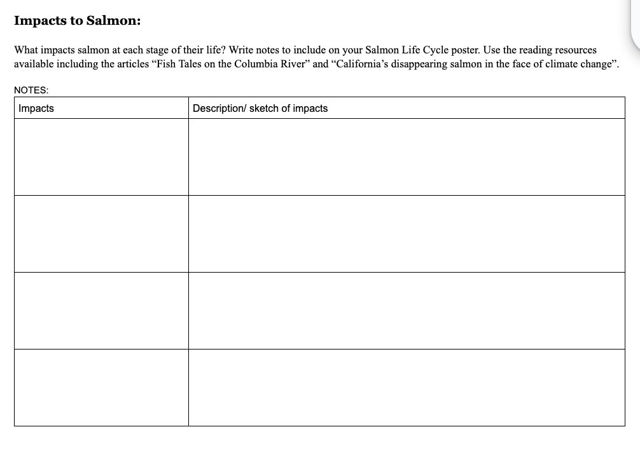
Research: What impacts salmon?
Read: “California’s disappearing salmon in the face of climate change”And “Fish tale on the Columbia River”. Use a highlighter to Identify 3-4 challenges (impacts) salmon face during their life cycle.
Add impacts to your note taking sheet.
Impacts
Notes:
https://newsela.com/view/ck9noojgn064f0iqjd7d912e7/?levelId=ck7ecwtg90w7w14p7cwe2jy4x
https://www.washingtonpost.com/nation/interactive/2021/california-disappearing-salmon/ (Washington Post)

Slide 9
WARM UP
Welcome back. NO INB. Collect a pencil and your Salmon Life Cycle notes.
Create a folder for your Salmon Life Cycle Illustration.
You will keep your salmon life cycle in your folder to showcase. You will add data analysis assessments and supporting work that you will do over the next few weeks. We are trying to puzzle out the following questions:
How are adult population of Chinook salmon changing over time?
What factors are contributing to changes in salmon population?
On your folder write:
Your FULL NAME.
The two questions starred above. Decorate your folder if time.
Remember class expectations: Voices off when teacher is talking.
Stay seated unless directed.

Slide 10
Work Day: Agenda
Complete reading to identify threats and record these on page two of your note taking sheet.
Complete Salmon life cycle illustration with notes on each stage and threats.
Complete Reflection Questions on pink sheet.
Extension video on Slide 18. Watch and record.
Keep your materials in your files and place in the INBOX for your period.

Slide 11
Illustration
Use your notes to complete a salmon life cycle on 11x17 paper.
Include the following:
Clear illustrations of each life stage of development.
Written information about each life stage based on your research.
Arrows to show the direction of development. Remember a cycle is a circle. Your life cycle should be a continuous loop from spawning through each stage of development and back to spawning.
Scientific accuracy in your drawings. Include correct markings, color and anatomical features. You may use your chromebook for support in this.

Slide 12
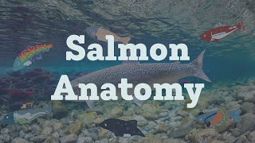
Salmon Anatomy

Slide 13
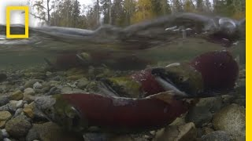
Warm Up: Salmon Migration
How well do you understand the life cycle of a salmon?
What impacts did you hear that you recognize. What was new?

Slide 14
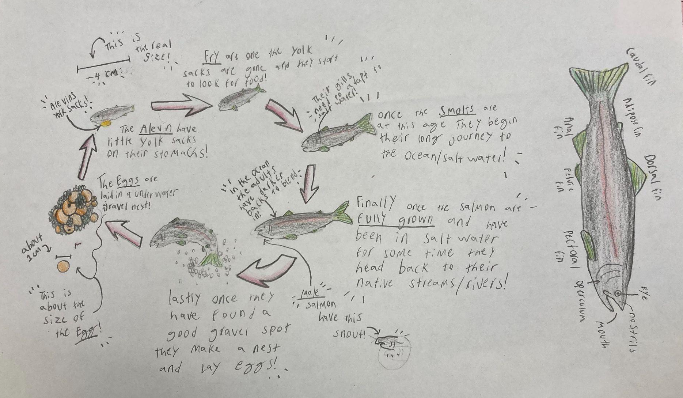
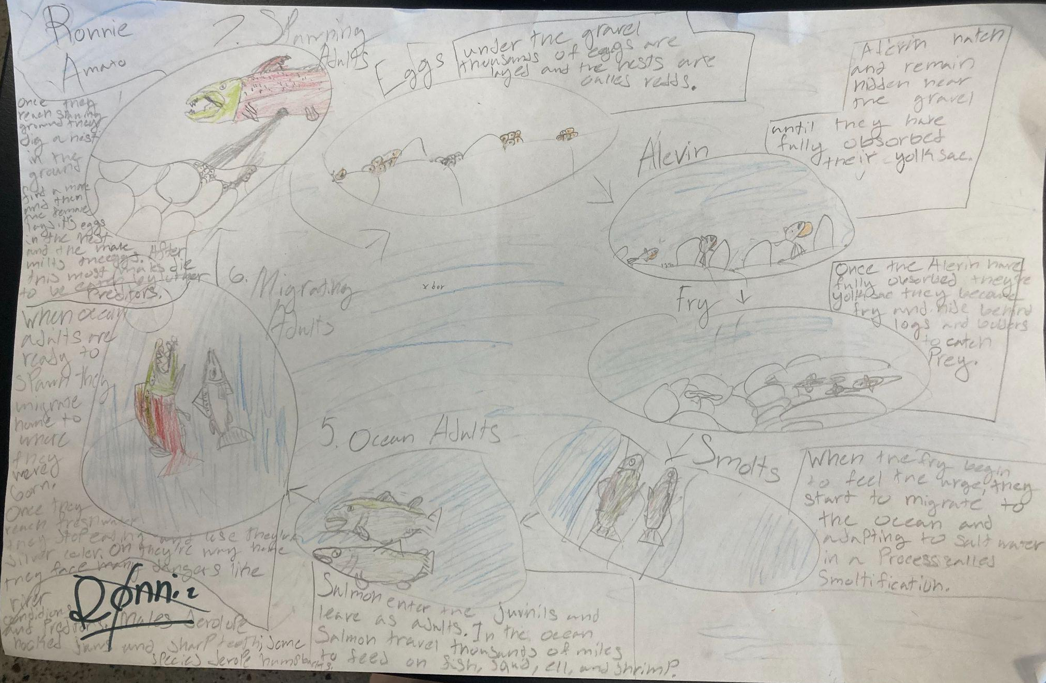
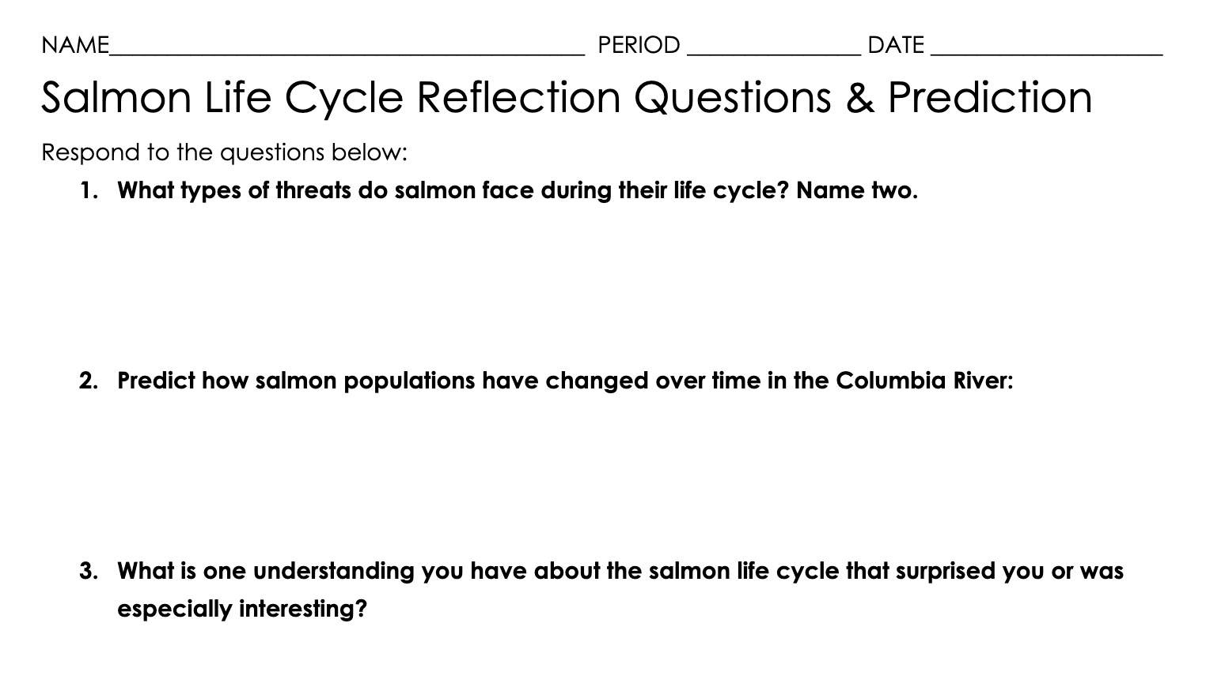
Work Day: Agenda
Complete Salmon life cycle illustration
with notes on each stage and threats.
Complete Reflection Questions on pink sheet. Make sure to record your prediction.
Extension video on Slide 20. Watch and record.
Keep your materials in your files and place in the INBOX for your period.

Slide 15
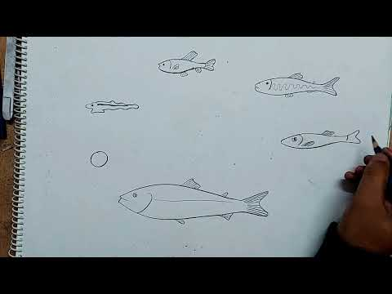
How to draw salmon life cycle

Slide 16
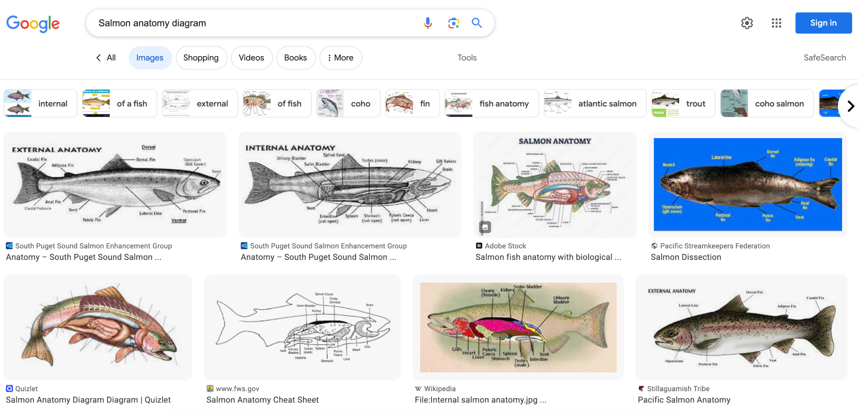
Research to identify the anatomical features of a salmon.

Slide 17
Exit Ticket: Reflection Questions
Complete the Salmon Life Cycle Reflection Questions. Use full sentences to share your thinking.
Check in for a stamp when you are done.

Slide 18
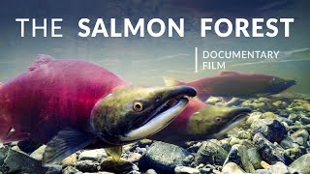
Extension: Slide 20.
Watch this 30 minute video. Take notes to answer the following:
Explain how the salmon and the forest are connected.
What role do salmon play in the ecology and in our society. List three on the white board.

